Slide 1
Lecture (2)
A Methodology is:
A specific approach that defines a collection of processes, methods and tools for accomplishing an objective.
It provides:
templates
forms
checklists of key deliverables and activities over the project life cycle to avoid missing key tasks

Slide 2
SDLC Methodologies vs.PM Methodologies:
Remarks:
SPM methodologies reduces the risk of project failure if used correctly.
Managing projects is a process that should be performed consistently regardless of the SDLC used
PM Methodologies | SDLC Methodologies
Provide a high-level project framework | Provides the detail on system design and development
project initiation, prioritization, project planning, status reporting, issue / decision /change management, quality management, risk management, etc. | Address specific steps, processes and deliverables associated with the type of projects being implemented

Slide 3
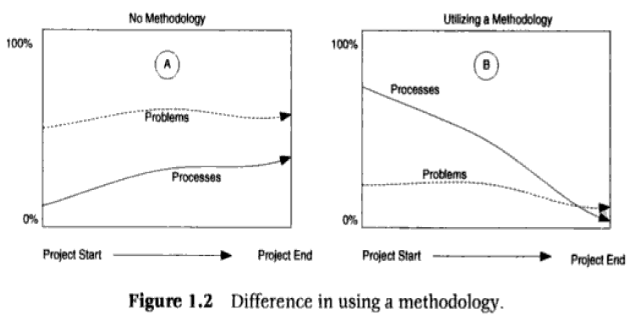

Slide 4
SPM Methodologies:
SPMM ” Stepwise Project Management Method“ | PRINCE2 “Project IN Controlled Environment” | PMBOK “Project Management Body of Knowledge”
Practicality tries to answer the question ‘what do I do now?’ | The UK standard for project management developed | IEEE Standard(1490-2003)
Scalability useful for small project as well as large | Sponsored by the Government and used in both the public and private sectors | PM methodology for North American projects
Used in wide Range of applications | Focuses more on procedural at the expense of techniques | Project process groups:
 | Divide projects into more manageable Stages (subset of project activities) | initiating, planning, executing, controlling and closing
Project knowledge areas: integration management, scope management, time management, cost management, quality management, Human Resource Management, Communication management, Risk management, procurement management

Slide 5
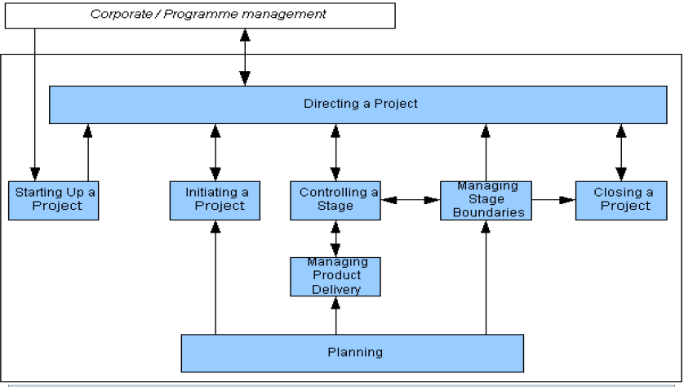
Diagram, phases, documents,adv,dis Adv.
PRINCE2 Methodology:

Slide 6
PRINCE2 Methodology (cont.):
Description | Process name | #
Occurs before the beginning of the project to make sure that the project has a very clear beginning, and to discuss how the project is to be carried out. information will be put together in a ‘Project Brief'. | Starting up a Project (SP) | 1
planning for the project to ensure that it meets its objectives. Detailed estimations of costs, needed time and other resources have to be made. Generate the Project Initiation Document (PID) for approval by the Project Board (PB). | Initiating a Project (IP) | 2
PRINCE2 is that divided a project into manageable stages. Each stage is planned in the stage preceding it , and Each project stage must be completed before the next stage can be started. | Controlling a Stage | 3

Slide 7
PRINCE2 Methodology (cont.):
Description | Process name | #
Preparing for the next stage and reviewing the current stage. The Project Manager makes suggestions to the PB about the project achievements and any changes in the business case, project plan, risks and issues. | Managing Stage Boundaries | 4
The goal of a PRINCE2 project is to deliver products. Everything produced in PRINCE2, even a document, is called a product. It is the Project Manager's responsibility to ensure that the ‘supplier’ produces the correct products at the right time. | Managing Product Delivery | 5
At the end of the project, after its products have been delivered, the project is closed down with approval of the PB. The Project Manager plans the Post Project Review (PPR). Any lessons learned are recorded, resources are released and the Post Project Review Plan (PPRP) is created. | Closing a Project | 6

Slide 8
PRINCE2 Methodology (cont.):
Description | Process name | #
Each project plan, stage plan and team plan must consider key planning aspects. - What products to produce - The activities required to produce these products - Estimated resources - Scheduling the activities - Analyzing risks. | Planning | 7
Approving the Project Brief and the PID by the Project Board (PB). During the rest of the project this PB has the overall responsibility for the success of the project. The Project Manager has the day to day responsibility. The Project Manager will inform the PB about the project's progress.. | Directing a Project | 8

Slide 9
PRINCE2 Documents:
Description | Document name | #
A short explanation of the need for the project, the management team, the structure and goals. | Project Brief | 1
A detailed description of the need for the project and its expected benefits (to all stakeholders in the project, including its owner, users and suppliers and sometimes the general public) | Business Case | 2
All information about risks | Risk register | 3
All information about the quality of the project | Quality register | 4
A set of notes about problems, complaints and concerns sent by all project members. | Issues register | 5
A set of notes of lessons learned (often the hard way) which may be useful to future projects. | Lessons log | 6
A diary about the project written by the project manager | Daily log | 7

Slide 10
PRINCE2 Advantages and Disadvantages:
Disadvantages | Advantages
Every person who works on a PRINCE2 project should be quite familiar with every aspect of PRINCE2 to know how to play the game | Providing a standard approach for project management
Using PRINCE2 means that a lot of documents and lists have to be written and approved by both Project Manager and PB | Widely recognized and understood
Splitting up a PRINCE2 project often results in a lack of knowledge of the project by responsible persons like the Project Manager. | PRINCE2 enables projects to have: - A controlled and organized start, middle and end - Regular reviews and control of progress against plan. - Flexible decision points - Good communication channels between the project, project management, and the rest of the organization

Slide 11
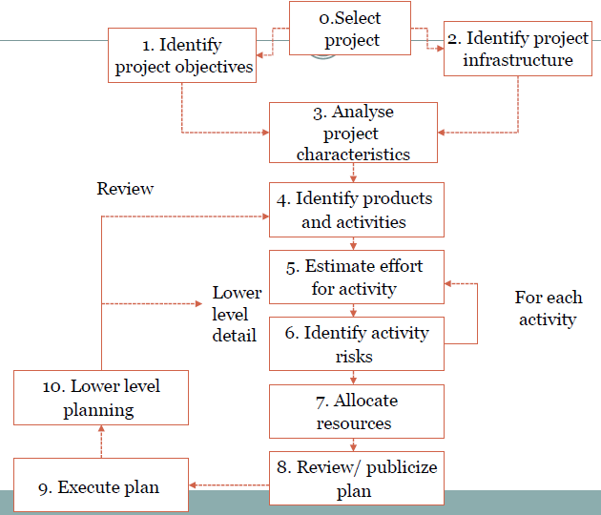
SPMM: Step Wise Methodology:

Slide 12
SPMM(cont.):
Sub Steps | Step name | #
1.1 Identify objectives and measures of effectiveness | establish project scope and objectives | 1
1.2 Establish a project authority
1.3 Identify all stakeholders in the project and their interests
1.4 Modify objectives in the light of stakeholder analysis
1.5 Establish methods of communication with all parties
2.1 Establish link between project and any strategic plan | Establish project infrastructure | 2
2.2 Identify installation standards and procedures
2.3. Identify project team organization

Slide 13
SPMM(cont.):
Sub Steps | Step name | #
3.1 Distinguish the project as either objective or product-based | Analysis of project characteristics | 3
3.2 Analyze other project characteristics (including quality based ones)
3.3 Identify high level project risks
3.4 Take into account user requirements concerning implementation
3.5 Select general life cycle approach
3.6 Review overall resource estimates
4.1 Identify and describe project products - ‘what do we have to produce?’ | Identify project products and activities | 4
4.2 document Generic product Flows
4.3 Produce ideal activity network
4.5 Add check-points if needed

Slide 14
SPMM(cont.):
Sub Steps | Step name | #
5.1 Carry out bottom-up estimates | Estimate effort for each activity | 5
5.2. Revise plan to create controllable activities
6.1.Identify and quantify risks for activities | Identify activity risks | 6
6.2. Plan risk reduction (activity to stop risk occurring) and contingency(action if risk does occur) Measures.
6.3 Adjust overall plans and estimates to take account of risks
7.1 Identify and allocate resources to activities | Allocate resources | 7
7.2 Revise plans and estimates to take into account resource constraints
8.1 Review quality aspects of project plan | Review/ Publish Plan | 8
8.2 Document plan and obtain agreement
 | Execute plan | 9
 | create lower level plans | 10

Slide 15
Criteria of choosing proper PM methodology:
Take into consideration what is popular in your geographic area.
Many project management methodologies address the management of a single project, without appreciating that many other projects in a company compete for the very same resources and attention.
Consistent project management methodology is mandatory for effective reporting and analysis
There is no one-size-fits-all methodology
You cannot simply use a methodology exactly as it stands.
You needed to modify and tailor whichever methodology you select to suit your own project needs.

Slide 16
Lecture (3)
System development Methodologies:
Model Name | Description | Methodology
waterfall | adopt a formal step-by-step approach to the SDLC that moves logically from one phase to the next. | Structured Methodologies
V-process
incremental delivery | adjust the SDLC phases to get some part of system developed quickly and into the hands of the users . recommend that analysts use special techniques and computer tools to speed up the analysis, design, and implementation phases, such as CASE (computer-aided software engineering) tools | RAD Methodologies
evolutionary development

Slide 17
System development Methodologies:
Waterfall model:
the analysts and users proceed sequentially from one phase to the next.
Models | Description | Methodology
DSDM | Structured development methods have some perceived | Agile Methodology
XP
Disadvantages | Advantages
The design must be completely specified before programming begins. | The system requirements are identified long before programming begins
A long time elapses between the completion of the system proposal in the analysis phase and the delivery of the system. | Changes to the requirements are minimized as the project proceeds.
Limited scope of iteration

Slide 18
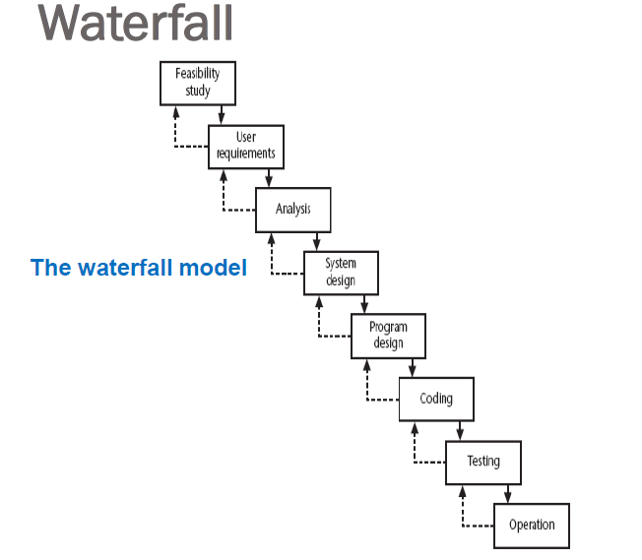
Waterfall model(cont.):

Slide 19
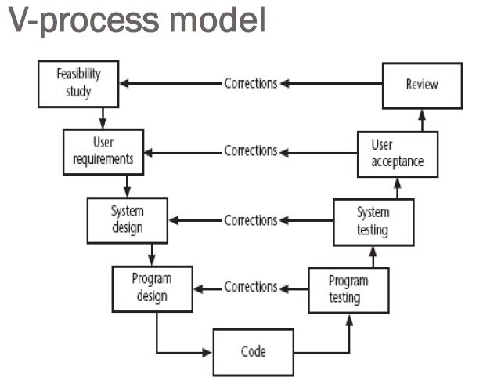
V-process Model

Slide 20
Evolutionary delivery:
Iterative process of creating quickly and inexpensively live and working models to test out requirements and assumptions.
Disadvantages | Advantages
users may misunderstand the role of the prototype | improved communication
lack of project control and standards possible | improved user involvement
additional expense of building prototype | a feedback loop is established
focus on user-friendly interface could be at expense of machine efficiency | reduces the need for documentation
 | reduces maintenance costs i.e. changes after the application goes live

Slide 21
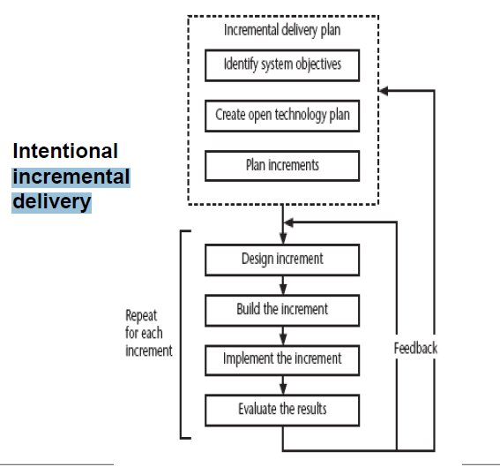
Incremental approach :

Slide 22
Agile Development :
Disadvantages
s to deliver anything produce large amounts of documentation which can be largely unread documentation has to be kept up to date division into specialist groups and need to follow procedures stifles communication users can be excluded from decision process long lead times to deliver anything

Slide 23
Dynamic system development method :
UK-based consortium .
DSDM is more a project management approach than a development approach
core DSDM principles
1. Active user involvement
2. Teams empowered to make decisions
3. Frequent delivery of products
4. Fitness for business purpose
5. Iterative and incremental delivery
6. Changes are reversible
7. Requirements base-lined at a high level
8. Testing integrated with development
9. Collaborative and co-operative approach

Slide 24
Extreme programming (XP):
Extreme Programming (XP) was founded on four core values:
Communication
Close interaction with the end users to build systems very quickly
Simplicity (Simple coding)
Feedback (Continuous testing)
Courage

